Slide 1
IMPORTANT: How to Use the Science Highlights Template
Make all edits in Microsoft PowerPoint. Do not edit in Google Slides, Open Office, or any other “compatible” program.
This is a template. Instructions for using it are available online.
To avoid confusion (and multiple masters), create a new presentation and rebuild old slides in the new presentation.
When cutting and pasting text, it is recommended you select “keep text only” then apply adjustments to font-size if needed, no smaller than Calibri 12pt.

Slide 2
About this Template
This template (.potx) offers a starter layout for an SC-DOE Highlight:
– Two-column “Scientific Achievement” over graphic right
To create your own slide, pull down the “new slide” menu and select a layout.
Adjust layouts as necessary.
– These are starting points, but you may need to resize boxes.
– Don’t shrink fonts too small (Please try to maintain font size provided in template. If necessary, the smallest approved font size is Calibri 12pt.)
Include talking points, a narrative, and/or more details in the notes section

Slide 3
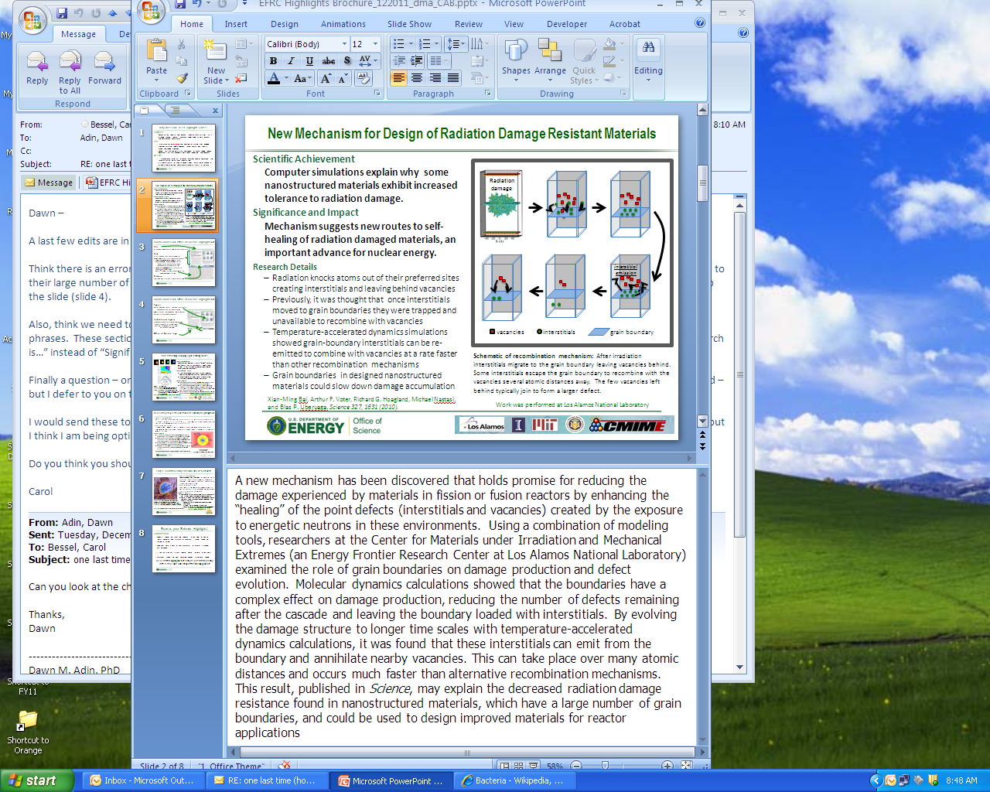
How to Build a DOE Office of Science Highlight Slide
Title
Attention grabbing and accessible but not exaggerated
Text
All text should be short and to the point –
minimize words and stress significance to society
Scientific Achievement – 50 words or less
Significance and Impact – 50 words or less
Importance, relevance, or intriguing component of the finding to the field
Research Involved – Address the research approach in 2-4 bullet points
Notes – Fill out the notes section so that presenters can speak to your slide. ~175 word explanation or bulleted talking points, plus additional description of figure if needed
Citation: If there is a publication, full citation with all authors’ names preferred

Slide 4
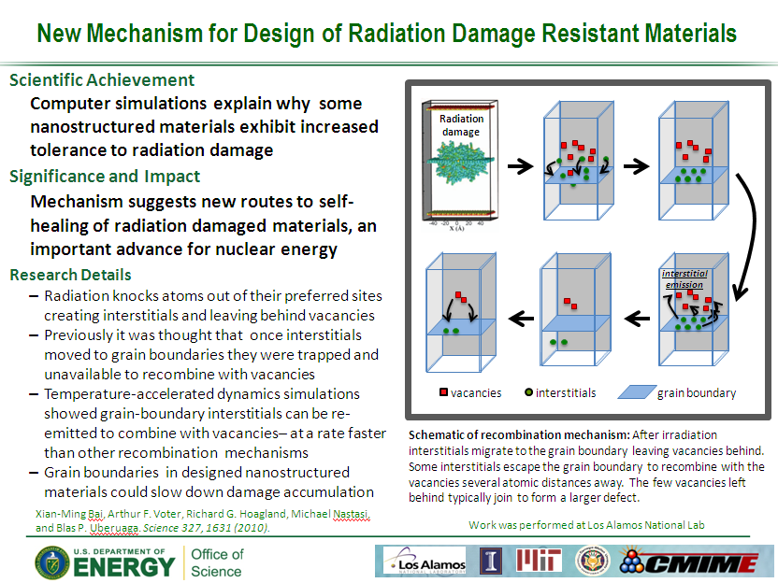
How to Build a DOE Office of Science Highlight Slide
Figures
Visually compelling figure(s) to explain the research
Include legends and descriptive caption
Provide Image Credit
Institutional logo(s)
Include affiliations or institutional logos
Indicate institution where research was
performed (if possible); EFRC and Hub research
should include those logos as well
SC Logos
For Office of Science

